Slide 1
Advanced Data mining
Tek Narayan Adhikari

Slide 2
Association Rule Mining
Given a set of transactions, find rules that will predict the occurrence of an item based on the occurrences of other items in the transaction
Market-Basket transactions
Example of Association Rules
{Diaper} → {Beer}, {Milk, Bread} → {Eggs,Coke}, {Beer, Bread} → {Milk},
Implication means co-occurrence, not causality!

Slide 3
Definition: Frequent Itemset
Itemset
A collection of one or more items
Example: {Milk, Bread, Diaper}
k-itemset
An itemset that contains k items
Support count (σ)
Frequency of occurrence of an itemset
E.g. σ({Milk, Bread,Diaper}) = 2
Support
Fraction of transactions that contain an itemset
E.g. s({Milk, Bread, Diaper}) = 2/5
Frequent Itemset
An itemset whose support is greater than or equal to a minsup threshold

Slide 4
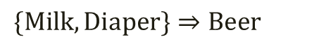
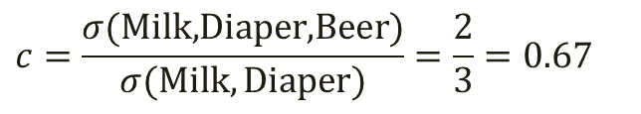
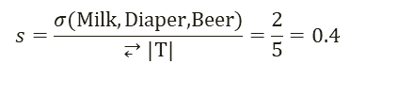
Definition: Association Rule
Association Rule
An implication expression of the form X → Y, where X and Y are itemsets
Example: {Milk, Diaper} → {Beer}
Rule Evaluation Metrics
Support (s)
Fraction of transactions that contain both X and Y
Confidence (c)
Measures how often items in Y appear in transactions that contain X
Example:
$$\{\text{Milk},\text{Diaper}\}⇒\text{Beer}$$
$$s=\frac{σ(\text{Milk},\text{Diaper}\text{,}\text{Beer})}{⥂|T|}=\frac{2}{5}=0.4$$
$$c=\frac{σ(\text{Milk}\text{,}\text{Diaper}\text{,}\text{Beer})}{σ(\text{Milk},\text{Diaper})}=\frac{2}{3}=0.67$$

Slide 5
Association Rule Mining Task
Given a set of transactions T, the goal of association rule mining is to find all rules having
support ≥ minsup threshold
confidence ≥ minconf threshold
Brute-force approach:
List all possible association rules
Compute the support and confidence for each rule
Prune rules that fail the minsup and minconf thresholds
⇒ Computationally prohibitive!

Slide 6
Mining Association Rules
Example of Rules:
{Milk,Diaper} → {Beer} (s=0.4, c=0.67) {Milk,Beer} → {Diaper} (s=0.4, c=1.0)
{Diaper,Beer} → {Milk} (s=0.4, c=0.67)
{Beer} → {Milk,Diaper} (s=0.4, c=0.67) {Diaper} → {Milk,Beer} (s=0.4, c=0.5)
{Milk} → {Diaper,Beer} (s=0.4, c=0.5)
Observations:
All the above rules are binary partitions of the same itemset: {Milk, Diaper, Beer}
Rules originating from the same itemset have identical support but can have different confidence
Thus, we may decouple the support and confidence requirements

Slide 7
Mining Association Rules
Two-step approach:
Frequent Itemset Generation
Generate all itemsets whose support ≥ minsup
Rule Generation
Generate high confidence rules from each frequent itemset, where each rule is a binary partitioning of a frequent itemset
Frequent itemset generation is still computationally expensive

Slide 8
Frequent Itemset Generation
Given d items, there are 2^{d} possible candidate itemsets

Slide 9
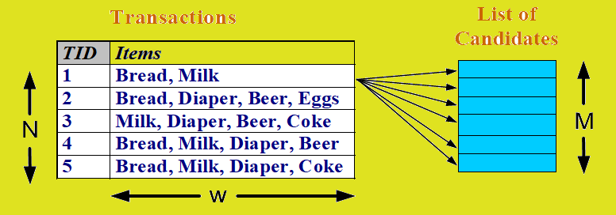
Frequent Itemset Generation
Brute-force approach:
Each itemset in the lattice is a candidate frequent itemset
Count the support of each candidate by scanning the database
Match each transaction against every candidate
Complexity ~ O(NMw) => Expensive since M = 2^{d} !!!

Slide 10
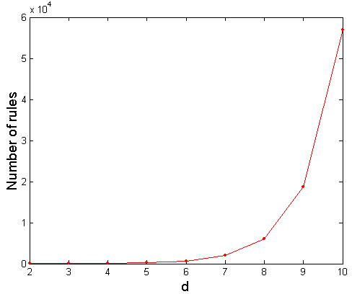
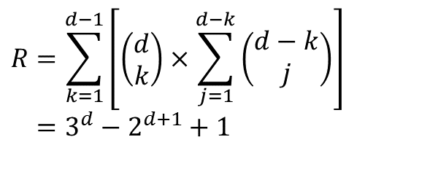
Computational Complexity
Given d unique items:
Total number of itemsets = 2^{d}
Total number of possible association rules:
$$R=\sum_{k=1}^{d−1}{\left[\left(\begin{matrix}d \\ k\end{matrix}\right)×\sum_{j=1}^{d−k}{\left(\begin{matrix}d−k \\ j\end{matrix}\right)}\right]} \\ =3^{d}−2^{d+1}+1$$
If d=6, R = 602 rules

Slide 11
Frequent Itemset Generation Strategies
Reduce the number of candidates (M)
Complete search: M=2^{d}
Use pruning techniques to reduce M
Reduce the number of transactions (N)
Reduce size of N as the size of itemset increases
Used by DHP and vertical-based mining algorithms
Reduce the number of comparisons (NM)
Use efficient data structures to store the candidates or transactions
No need to match every candidate against every transaction

Slide 12
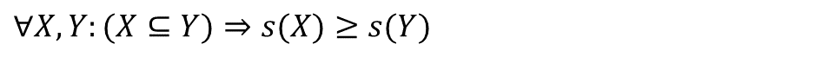
Reducing Number of Candidates
Apriori principle:
If an itemset is frequent, then all of its subsets must also be frequent
Apriori principle holds due to the following property of the support measure:
Support of an itemset never exceeds the support of its subsets
This is known as the anti-monotone property of support
$$∀X,Y:(X⊆Y)⇒s(X)≥s(Y)$$

Slide 13
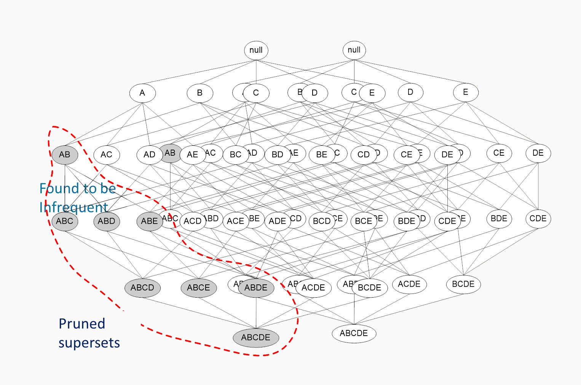
Illustrating Apriori Principle

Slide 14
Illustrating Apriori Principle
Items (1-itemsets)
Pairs (2-itemsets)
(No need to generate candidates involving Coke or Eggs)
Minimum Support = 3
Triplets (3-itemsets)
If every subset is considered,
⁶C₁ + ⁶C₂ + ⁶C₃ = 41
With support-based pruning,
6 + 6 + 1 = 13

Slide 15
Apriori Algorithm
Method:
Let k=1
Generate frequent itemsets of length 1
Repeat until no new frequent itemsets are identified
Generate length (k+1) candidate itemsets from length k frequent itemsets
Prune candidate itemsets containing subsets of length k that are infrequent
Count the support of each candidate by scanning the DB
Eliminate candidates that are infrequent, leaving only those that are frequent

Slide 16
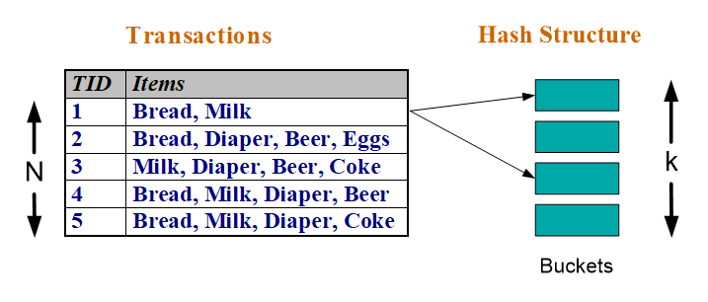
Reducing Number of Comparisons
Candidate counting:
Scan the database of transactions to determine the support of each candidate itemset
To reduce the number of comparisons, store the candidates in a hash structure
Instead of matching each transaction against every candidate, match it against candidates contained in the hashed buckets

Slide 17
Example of Apriori algorithm
Consider the following transaction table
Transaction No | Items
T1 | 1,2,3,4,5,6
T2 | 7,2,3,4,5,6
T3 | 1,8,4,5
T4 | 1,9,0,4,6
T5 | 0,2,4,5

Slide 18
Example of Apriori algorithm
Step 1: Count the occurrence of each item.
Item | Occurrence
1 | 3
2 | 3
3 | 2
4 | 5
5 | 4
6 | 3
7 | 1
8 | 1
9 | 1
0 | 2

Slide 19
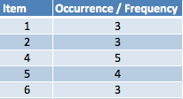
Example of Apriori algorithm
Step 2: Remember, the algorithm says, an item is considered to be frequent if it's bought more then the Support/Threshold i.e. 3. Therefore, below is the list of Frequent Singletons.

Slide 20
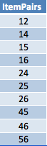
Example of Apriori algorithm
Step 3: We start making pairs out of the frequent itemsets we got in the above step.

Slide 21
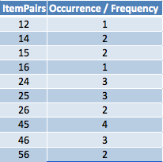
Example of Apriori algorithm
Step 4: After getting the frequent Item Pairs, we start counting the occurrence of these pairs in the Transaction Set.

Slide 22
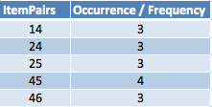
Example of Apriori algorithm
Step 5: Now again, follow the Golden Rule, and discard non-frequent paris.

Slide 23
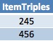
Example of Apriori algorithm
Now we have a table with pair of frequent items. Suppose we want to find frequent triplets. We the above table and make all the possible combinations.
Step 6: Make combinations of triples using the frequent Item pairs.
To make triples, the rule is: IF 12 and 13 are frequent, then the triple would be 123. Similarly, if 24 and 26 then triple would be 246.
So, using the above logic and our Frequent ItemPairs table, we get the below triples:

Slide 24
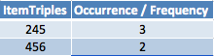
Example of Apriori algorithm
Step 7: Get the count of the above triples (Candidates).
After, this, if we can find quartets, then we find those and count their occurrence/frequency.
If we had 123, 124, 134, 135, 234 and we wanted to generate a quartet then it would be 1234 and 1345. And after finding quartet we would have again got their count of occurrence /frequency and repeated the same also, until the Frequent ItemSet is null.

Slide 25
Example of Apriori algorithm
Thus, the frequent ItemSets are:
Frequent Itemsets of Size 1: 1, 2, 4, 5, 6
Frequent Itemsets of Size 2: 14, 24, 25, 45, 46
Frequent Itemsets of Size 3: 245

Slide 26
Example of Apriori algorithm
Now if we want to check the association rule for {2, 4} -> 5. The confidence is: Ratio of {2, 4} U {5} with support of {2, 4}. Therefore,
Confidence = 3 / 3 => 1
We can say that, {2, 4} -> {5} has a confidence of 1. But, we want to know how interesting the rule is. For this, we have an new parameter called Interest.
Interest of an association rule is the difference of it's confidence and the fraction of baskets which contain item j.
({2, 4} -> 5) = conf( {2, 4} -> 5) - Fr(5)
= 1 - (3/4)
= 1 - .75
= .25
Therefore, the Interest is just 25 %. It's not an interesting rule.

Slide 27
Frequent Pattern (FP) Growth Method
Mining frequent itmesets without candidate generation.
It is a divide and conquers strategy.
It compress the database representing frequent items into a frequent –pattern tree (FP-Tree), which retains the itemset association information.
Divides the compressed database into a set of conditional databases, each associated with one frequent item or pattern fragment and then mines each such database separately.

Slide 28
Frequent Pattern (FP) Growth Method
Choice of minimum support threshold: Lowering support threshold results in more frequent itemsets.This may increase number of candidates and max length of frequent itemsets.
Dimensionality (number of items) of the data set: More space is needed to store support count of each item. If number of frequent items increases, both computation and I/O costs may also increase.
Size of database: Since Apriori makes multiple passes, run time of algorithm may increase with number of transactions.
Average transaction width: Transaction width increases with denser data sets. This may increase max length of frequent itemsets and traversals of hash tree (number of subsets in a transaction increases with its width)

Slide 29
Apriori and Fp-Growth difference
Apriori: uses a generate-and-test approach – generates candidate itemsets and tests if they are frequent
Generation of candidate itemsets is expensive(in both space and time)
Support counting is expensive
Subset checking (computationally expensive)
Multiple Database scans (I/O)
FP-Growth: allows frequent itemset discovery without candidate itemset generation. Two step approach:
Step 1: Build a compact data structure called the FP-tree
Built using 2 passes over the data-set.
Step 2: Extracts frequent itemsets directly from the FP-tree

Slide 30
Frequent Pattern (FP) Growth Method
FP-Growth method transforms the problem of finding long frequent patterns to searching for shorter ones recursively and then concatenating the suffix.
It uses least frequent items as suffix .
Advantage: Reduce search cost, has good selectivity, faster than apriori.
Disadvantage: When the database is large, it is sometimes unrealistic to construct a man memory based FP-tree.

Slide 31
Step 1: FP-Tree Construction
FP-Tree is constructed using 2 passes over the data-set:
Pass 1:
Scan data and find support for each item.
Discard infrequent items.
Sort frequent items in decreasing order based on their support.
Use this order when building the FP-Tree, so common prefixes can be shared.

Slide 32
Step 1: FP-Tree Construction
Pass 2:
Nodes correspond to items and have a counter
FP-Growth reads 1 transaction at a time and maps it to a path
Fixed order is used, so paths can overlap when transactions share items (when they have the same prfix).
In this case, counters are incremented
Pointers are maintained between nodes containing the same item, creating singly linked lists (dotted lines)
The more paths that overlap, the higher the compression. FP-tree may fit in memory.
Frequent itemsets extracted from the FP-Tree.

Slide 33
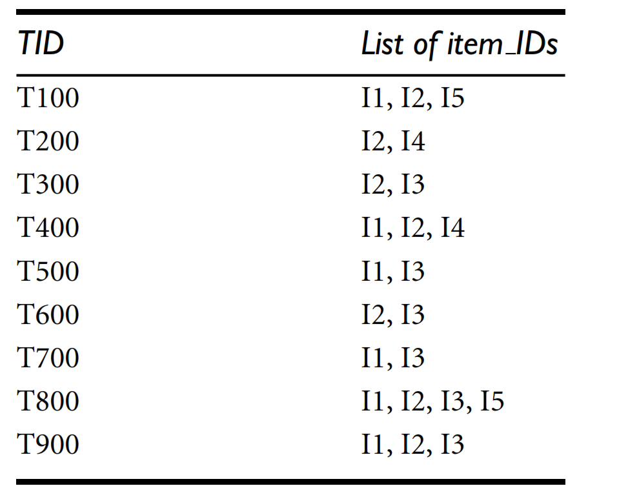
Example

Slide 34
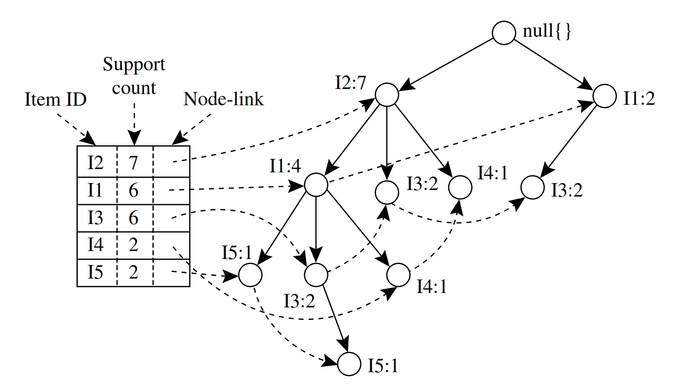
FP-Tree Construction (Example)

Slide 35
Step 2: Extracts frequent itemsets from the FP-tree
The FP-tree is mined as follows.
Start from each frequent length-1 pattern (as an initial sufﬁx pattern), construct its conditional pattern base (a sub-database, which consists of the set of preﬁx paths in the FP-tree co-occurring with the sufﬁx pattern),
Then construct its (conditional) FP-tree, and performmining recursively on the tree.
The pattern growth is achieved by the concatenation of the sufﬁx pattern with the frequent patterns generated from a conditional FP-tree.
We ﬁrst consider I5, which is the last item in L, rather than the ﬁrst. The reason for starting at the end of the list will become apparent as we explain the FP-tree mining process.

Slide 36
Step 2: Extracts frequent itemsets from the FP-tree
For I4, its two preﬁx paths form the conditional pattern base, (I2 I1: 1), (I2: 1), which generates a single-node conditional FP-tree, (I2: 2), and derives one frequent pattern,(I2, I4: 2).
Similar to the preceding analysis, I3’s conditional pattern base is {{I2, I1: 2}, {I2: 2},{I1: 2}}. Its conditional FP-tree has two branches, {I2: 4, I1: 2} and {I1: 2} as shown Figure , which generates the set of patterns {{I2, I3: 4}, {I1, I3: 4}, {I2, I1, I3: 2}}.
Finally, I1’s conditional pattern base is {{I2: 4}, with an FP-tree that contains only one node,{I2: 4}, which generates one frequent pattern, {I2, I1: 4}.
The paths formed by these branches are h (I2, I1, I5: 1) and (I2, I1, I3, I5: 1) . Therefore, considering I5 as a sufﬁx, its corresponding two preﬁx paths are ( I2, I1: 1) and (I2, I1, I3: 1), which form its conditional pattern base.
Using this conditional pattern base as a transaction database, we build an I5-conditional FP-tree, which contains only a single path, (I2: 2, I1: 2); I3 is not included because its support count of 1 is less than the minimum support count.
The single path generates all the combinations of frequent patterns: ( I2, I5: 2), (I1, I5: 2), (I2, I1, I5: 2).

Slide 37
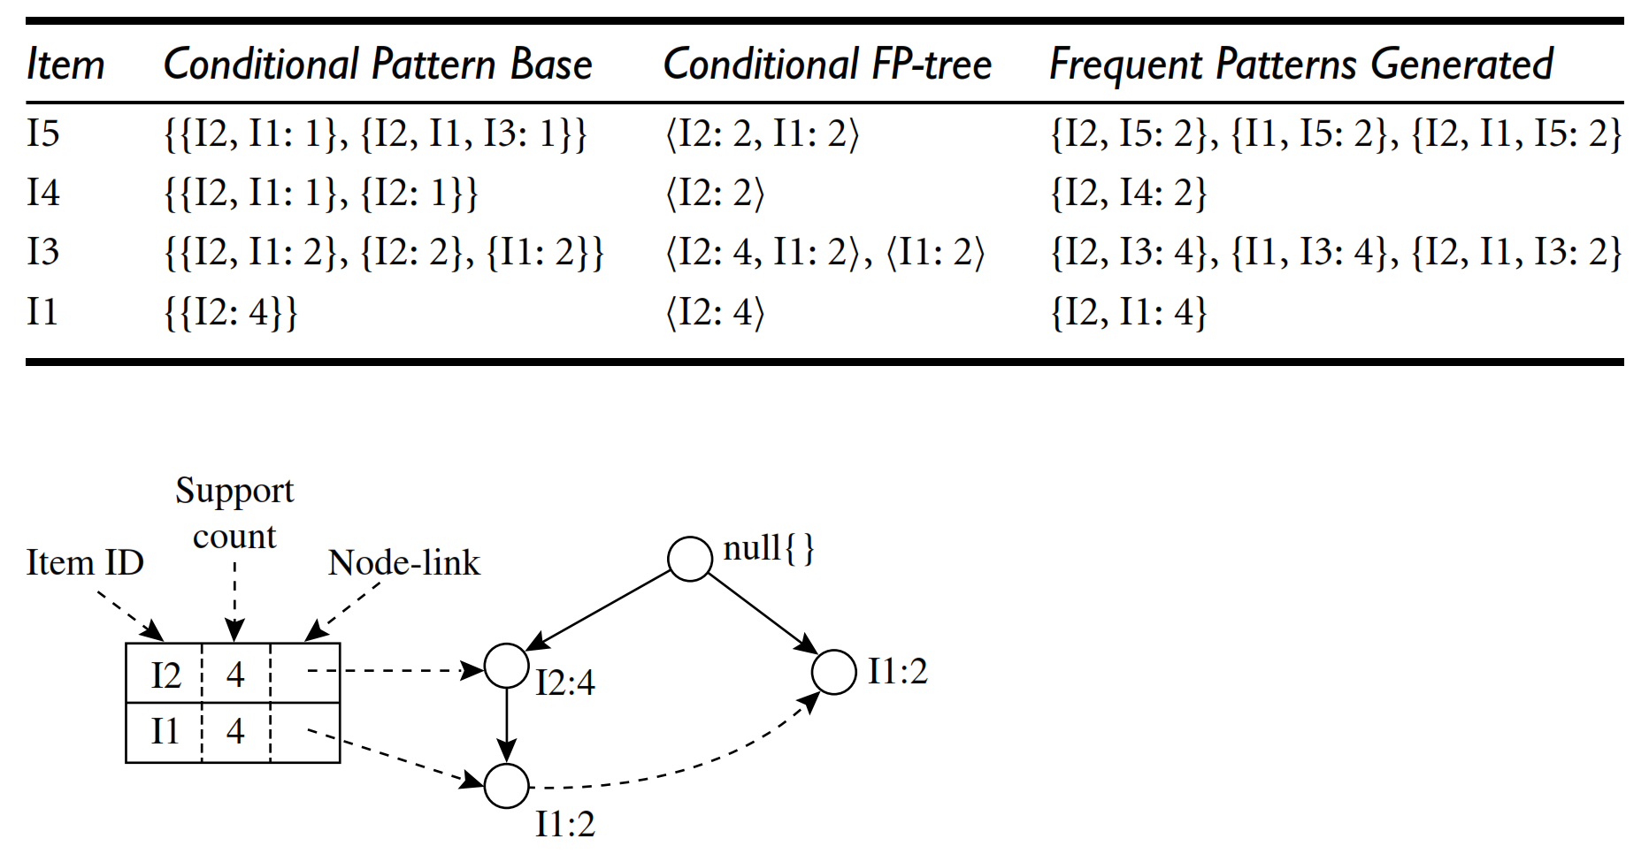
Step 2: Extracts frequent itemsets from the FP-tree

Slide 38
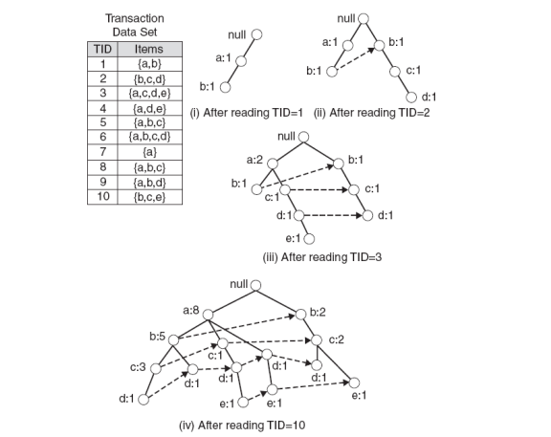
Next Example

Slide 39
FP-Tree size
The FP-Tree usually has a smaller size than the uncompressed data - typically many transactions share items (and hence prefixes).
Best case scenario: all transactions contain the same set of items.
1 path in the FP-tree
Worst case scenario: every transaction has a unique set of items (no items in common)
Size of the FP-tree is at least as large as the original data.
Storage requirements for the FP-tree are higher - need to store the pointers between the nodes and the counters.
The size of the FP-tree depends on how the items are ordered
Ordering by decreasing support is typically used but it does not always lead to the smallest tree (it's a heuristic).

Slide 40
Step 2: Frequent Itemset Generation
FP-Growth extracts frequent itemsets from the FP-tree.
Bottom-up algorithm - from the leaves towards the root
Divide and conquer: first look for frequent itemsets ending in e, then de, etc. . . then d, then cd, etc. . .
First, extract prefix path sub-trees ending in an item(set). (hint: use the linked lists)

Slide 41
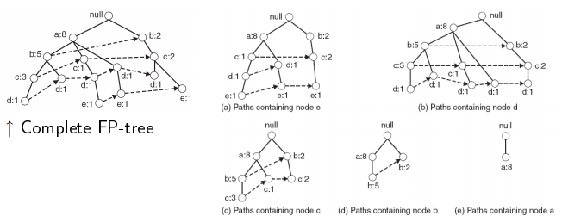
Prefix path sub-trees (Example)

Slide 42
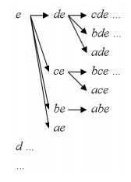
Step 2: Frequent Itemset Generation
Each prefix path sub-tree is processed recursively to extract the frequent itemsets. Solutions are then merged.
E.g. the prefix path sub-tree for e will be used to extract frequent itemsets ending in e, then in de, ce, be and ae, then in cde, bde, cde, etc.
Divide and conquer approach

Slide 43
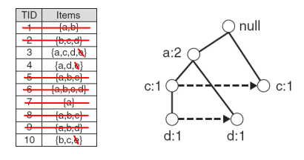
Conditional FP-Tree
The FP-Tree that would be built if we only consider transactions containing a particular itemset (and then removing that itemset from all transactions).
Example: FP-Tree conditional one.

Slide 44
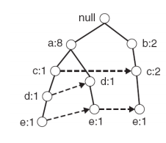
Example
Let minSup = 2 and extract all frequent itemsets containing e.
1. Obtain the prefix path sub-tree for e:

Slide 45
Example
2. Check if e is a frequent item by adding the counts along the linked list (dotted line). If so, extract it.
Yes, count =3 so {e} is extracted as a frequent itemset.
3. As e is frequent, find frequent itemsets ending in e. i.e. de, ce, be and ae.

Slide 46
Example
4. Use the the conditional FP-tree for e to find frequent itemsets ending in de, ce and ae
Note that be is not considered as b is not in the conditional FP-tree for e.
I For each of them (e.g. de), find the prefix paths from the conditional tree for e, extract frequent itemsets, generate conditional FP-tree, etc... (recursive)

Slide 47
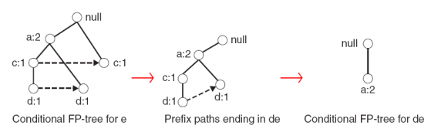
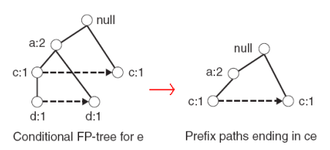
Example
Example: e -> de -> ade ({d,e}, {a,d,e} are found to be frequent)
Example: e -> ce ({c,e} is found to be frequent)

Slide 48
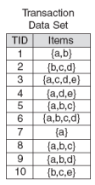
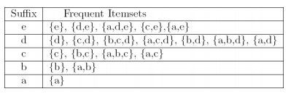
Result
Frequent itemsets found (ordered by sufix and order in which they are found):

Slide 49
Advantages and disadvantages
Advantages of FP-Growth
only 2 passes over data-set
“compresses” data-set
no candidate generation
much faster than Apriori
Disadvantages of FP-Growth
FP-Tree may not fit in memory!!
FP-Tree is expensive to build

Slide 50
Factors Affecting Complexity
Choice of minimum support threshold
lowering support threshold results in more frequent itemsets
this may increase number of candidates and max length of frequent itemsets
Dimensionality (number of items) of the data set
more space is needed to store support count of each item
if number of frequent items also increases, both computation and I/O costs may also increase
Size of database
since Apriori makes multiple passes, run time of algorithm may increase with number of transactions
Average transaction width
transaction width increases with denser data sets
This may increase max length of frequent itemsets and traversals of hash tree (number of subsets in a transaction increases with its width)

Slide 51
Maximal Frequent Itemset
An itemset is maximal frequent if none of its immediate supersets is frequent
Maximal Itemsets
Infrequent Itemsets
Border

Slide 52
Closed Itemset
An itemset is closed if none of its immediate supersets has the same support as the itemset

Slide 53
Maximal vs Closed Itemsets
Transaction Ids
Not supported by any transactions

Slide 54
Maximal vs Closed Frequent Itemsets
Minimum support = 2
Closed but not maximal
Closed and maximal
# Closed = 9
# Maximal = 4

Slide 55
Maximal vs Closed Itemsets

Slide 56
Alternative Methods for Frequent Itemset Generation
Representation of Database
horizontal vs vertical data layout

Slide 57
Projected Database
Projected Database for node A:
Original Database:
For each transaction T, projected transaction at node A is T ∩ E(A)

Slide 58
ECLAT
For each item, store a list of transaction ids (tids)
TID-list

Slide 59
ECLAT
Determine support of any k-itemset by intersecting tid-lists of two of its (k-1) subsets.
3 traversal approaches:
top-down, bottom-up and hybrid
Advantage: very fast support counting
Disadvantage: intermediate tid-lists may become too large for memory
∧
→

Slide 60
Rule Generation
Given a frequent itemset L, find all non-empty subsets f ⊂ L such that f → L – f satisfies the minimum confidence requirement
If {A,B,C,D} is a frequent itemset, candidate rules:
ABC →D, ABD →C, ACD →B, BCD →A, A →BCD, B →ACD, C →ABD, D →ABC AB →CD, AC → BD, AD → BC, BC →AD, BD →AC, CD →AB,
If |L| = k, then there are 2^{k} – 2 candidate association rules (ignoring L → ∅ and ∅ → L)

Slide 61
Rule Generation
How to efficiently generate rules from frequent itemsets?
In general, confidence does not have an anti-monotone property
c(ABC →D) can be larger or smaller than c(AB →D)
But confidence of rules generated from the same itemset has an anti-monotone property
e.g., L = {A,B,C,D}: c(ABC → D) ≥ c(AB → CD) ≥ c(A → BCD)
Confidence is anti-monotone w.r.t. number of items on the RHS of the rule

Slide 62
Rule Generation for Apriori Algorithm
Lattice of rules
Low Confidence Rule
Pruned Rules

Slide 63
Rule Generation for Apriori Algorithm
Candidate rule is generated by merging two rules that share the same prefix in the rule consequent
join(CD=>AB,BD=>AC) would produce the candidate rule D => ABC
Prune rule D=>ABC if its subset AD=>BC does not have high confidence

Slide 64
Effect of Support Distribution
How to set the appropriate minsup threshold?
If minsup is set too high, we could miss itemsets involving interesting rare items (e.g., expensive products)
If minsup is set too low, it is computationally expensive and the number of itemsets is very large
Using a single minimum support threshold may not be effective

Slide 65
Multiple Minimum Support
How to apply multiple minimum supports?
MS(i): minimum support for item i
e.g.: MS(Milk)=5%, MS(Coke) = 3%, MS(Broccoli)=0.1%, MS(Salmon)=0.5%
MS({Milk, Broccoli}) = min (MS(Milk), MS(Broccoli)) = 0.1%
Challenge: Support is no longer anti-monotone
Suppose: Support(Milk, Coke) = 1.5% and Support(Milk, Coke, Broccoli) = 0.5%
{Milk,Coke} is infrequent but {Milk,Coke,Broccoli} is frequent

Slide 66
Multiple Minimum Support

Slide 67
Multiple Minimum Support

Slide 68
Multiple Minimum Support (Liu 1999)
Order the items according to their minimum support (in ascending order)
e.g.: MS(Milk)=5%, MS(Coke) = 3%, MS(Broccoli)=0.1%, MS(Salmon)=0.5%
Ordering: Broccoli, Salmon, Coke, Milk
Need to modify Apriori such that:
L₁ : set of frequent items
F₁ : set of items whose support is ≥ MS(1) where MS(1) is min_{i}( MS(i) )
C₂ : candidate itemsets of size 2 is generated from F₁ instead of L₁

Slide 69
Multiple Minimum Support (Liu 1999)
Modifications to Apriori:
In traditional Apriori,
A candidate (k+1)-itemset is generated by merging two frequent itemsets of size k
The candidate is pruned if it contains any infrequent subsets of size k
Pruning step has to be modified:
Prune only if subset contains the first item
e.g.: Candidate={Broccoli, Coke, Milk} (ordered according to minimum support)
{Broccoli, Coke} and {Broccoli, Milk} are frequent but {Coke, Milk} is infrequent
Candidate is not pruned because {Coke,Milk} does not contain the first item, i.e., Broccoli.

Slide 70
Pattern Evaluation
Association rule algorithms tend to produce too many rules
many of them are uninteresting or redundant
Redundant if {A,B,C} → {D} and {A,B} → {D} have same support & confidence
Interestingness measures can be used to prune/rank the derived patterns
In the original formulation of association rules, support & confidence are the only measures used

Slide 71
Application of Interestingness Measure
Interestingness Measures

Slide 72
Computing Interestingness Measure
Given a rule X → Y, information needed to compute rule interestingness can be obtained from a contingency table
Contingency table for X → Y
 | Y | Y
X | f₁₁ | f₁₀ | f₁₊
X | f₀₁ | f₀₀ | f_{o+}
 | f₊₁ | f₊₀ | |T|
f₁₁: support of X and Y f₁₀: support of X and Y f₀₁: support of X and Y f₀₀: support of X and Y
Used to define various measures
support, confidence, lift, Gini, J-measure, etc.

Slide 73
Drawback of Confidence
 | Coffee | Coffee
Tea | 15 | 5 | 20
Tea | 75 | 5 | 80
 | 90 | 10 | 100
Association Rule: Tea → Coffee
Confidence= P(Coffee|Tea) =15/20= 0.75
but P(Coffee) = 90/100=0.9
Although confidence is high, rule is misleading
P(Coffee|Tea) = 75/80=0.9375

Slide 74
Statistical Independence
Population of 1000 students
600 students know how to swim (S)
700 students know how to bike (B)
420 students know how to swim and bike (S,B)
P(S∧B) = 420/1000 = 0.42
P(S) × P(B) = 0.6 × 0.7 = 0.42
P(S∧B) = P(S) × P(B) => Statistical independence
P(S∧B) > P(S) × P(B) => Positively correlated
P(S∧B) < P(S) × P(B) => Negatively correlated

Slide 75

Statistical-based Measures
Measures that take into account statistical dependence
$$Lift=\frac{P(Y|X)}{P(Y)} \\ Interest=\frac{P(X,Y)}{P(X)P(Y)} \\ PS=P(X,Y)−P(X)P(Y) \\ φ−coefficient=\frac{P(X,Y)−P(X)P(Y)}{\sqrt{P(X)[1−P(X)]P(Y)[1−P(Y)]}}$$

Slide 76
Example: Lift/Interest
 | Coffee | Coffee
Tea | 15 | 5 | 20
Tea | 75 | 5 | 80
 | 90 | 10 | 100
Association Rule: Tea → Coffee
Confidence= P(Coffee|Tea) = 0.75
but P(Coffee) = 0.9
Lift = 0.75/0.9= 0.8333 (< 1, therefore is negatively associated)

Slide 77


Drawback of Lift & Interest
 | Y | Y
X | 10 | 0 | 10
X | 0 | 90 | 90
 | 10 | 90 | 100
 | Y | Y
X | 90 | 0 | 90
X | 0 | 10 | 10
 | 90 | 10 | 100
$$Lift=\frac{0.1}{(0.1)(0.1)}=10$$
$$Lift=\frac{0.9}{(0.9)(0.9)}=1.11$$
Statistical independence:
If P(X,Y)=P(X)P(Y) => Lift = 1

Slide 78
Reducing Number of Comparisons
Candidate counting:
Scan the database of transactions to determine the support of each candidate itemset.
To reduce the number of comparisons, store the candidates in a hash structure
Instead of matching each transaction against every candidate, match it against candidates contained in the hashed buckets

Slide 79
Hash Table
A hash table (hash map) is a data structure used to implement an associative array, a structure that can map keys to values.
A hash table uses a hash function to compute an index into an array of buckets or slots, from which the correct value can be found.
Max leaf size: max number of itemsets stored in a leaf node, if number of candidate itemsets exceeds max leaf size, split the node

Slide 80
Categorical data
Categorical data is a statistical data type consisting of categorical variables, used for observed data whose value is one of a fixed number of nominal categories.
More specifically, categorical data may derive from either or both of observations made of qualitative data, where the observations are summarized as counts or cross tabulations, or of quantitative data.
Observations might be directly observed counts of events happening or they might counts of values that occur within given intervals.
Often, purely categorical data are summarized in the form of a contingency table.
However, particularly when considering data analysis, it is common to use the term "categorical data" to apply to data sets that, while containing some categorical variables, may also contain non-categorical variables.

Slide 81
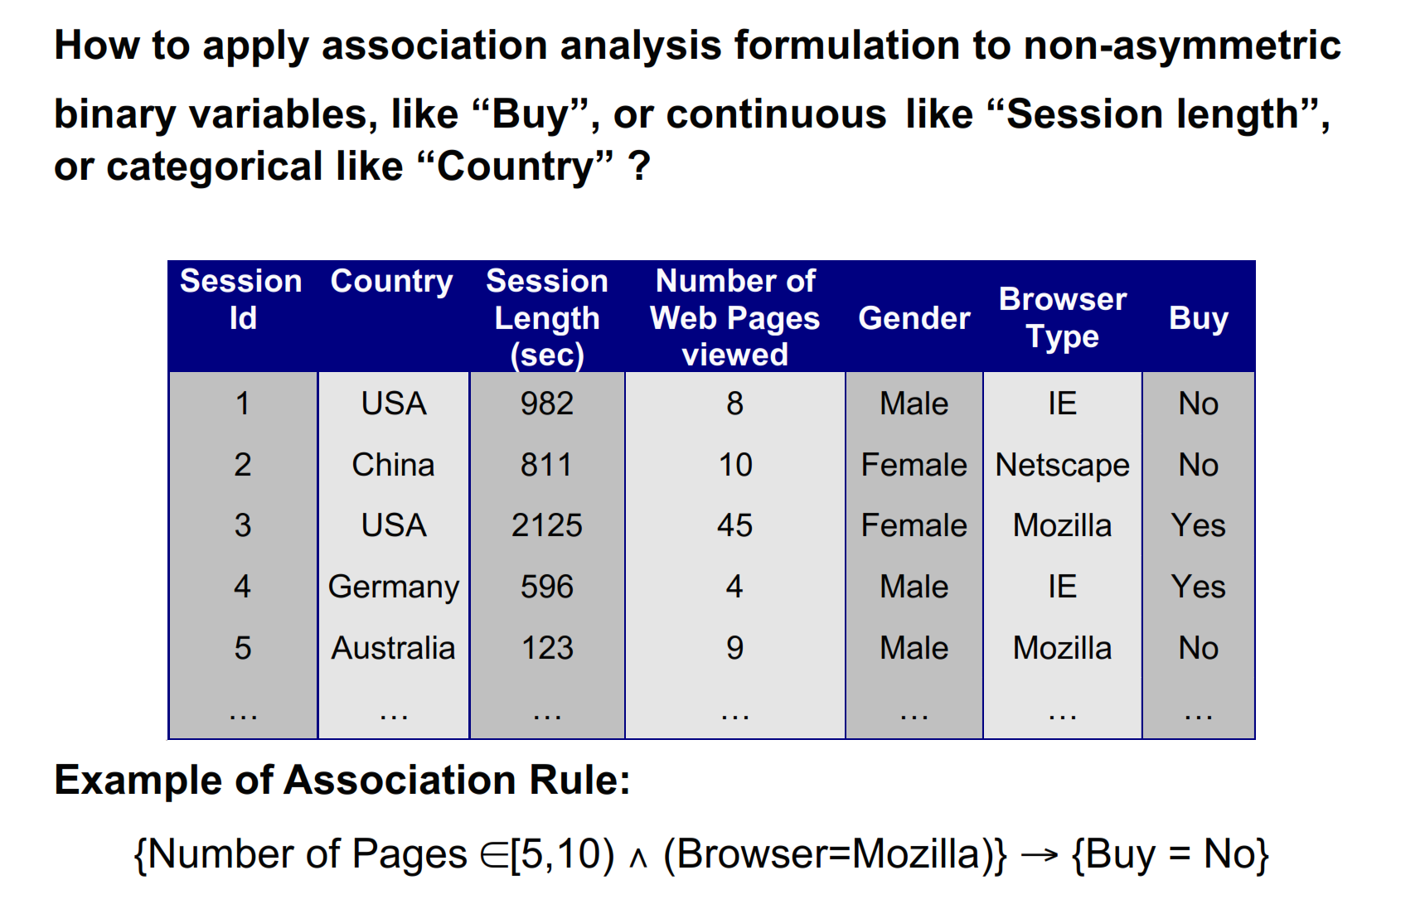
Example

Slide 82
Potential Issues
What if attribute has many possible values: Example: attribute country has more than 200 possible values. Many of the attribute values may have very low support.
Potential solution: Aggregate the low-support attributes values.
What if distribution of attribute values is highly skewed: Example: 95% of the visitors have Buy = No. Most of the items will be associated with (Buy=No) item
Potential solution: drop the highly frequent items
Handling Categorical Attributes
Transform categorical attribute into asymmetric binary variables. i.e If the outcomes of a binary variable are not equally important.
Introduce a new “item” for each distinct attribute- value pair.

Slide 83
Sequential Pattern
Mining of frequently occurring ordered events or subsequences as patterns. Eg: web sequence, book issued in library etc.
Used mostly in marketing, customer analysis, prediction modeling.
A sequence is an ordered list of events where an item can occur at most in an event of a sequence but can occur multiple times in different events of a sequence.
Given a set of sequences, where each sequence consists of a list of events or elements and each event consists of set of items, given a minimum support threshold, sequential pattern mining finds all frequent subsequences.
Sequence with minimum support is called frequent sequence or sequential pattern.
A sequential pattern with length ‘l’ is called an l-pattern sequential pattern.

Slide 84
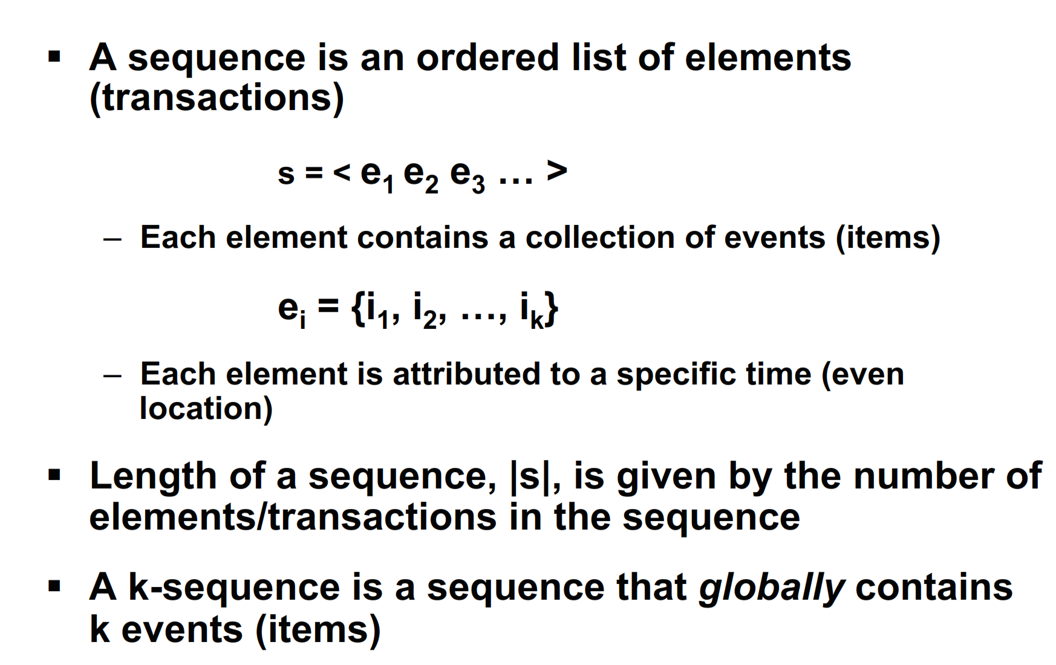
Defination

Slide 85
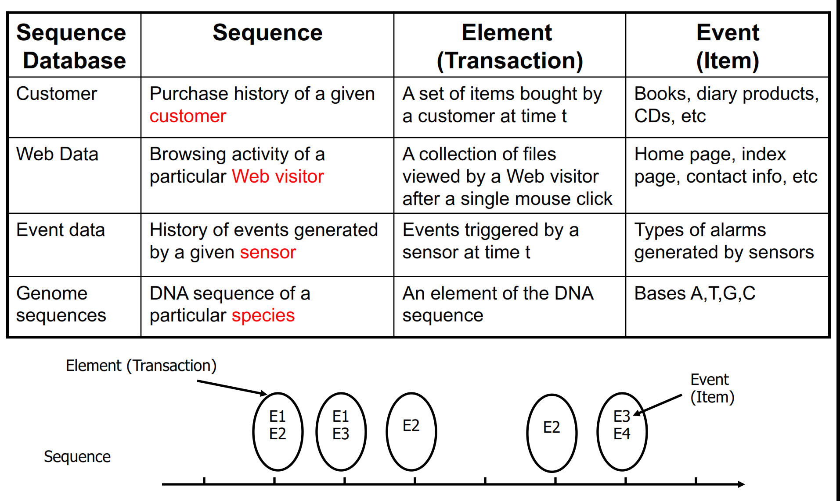
Example

Slide 86
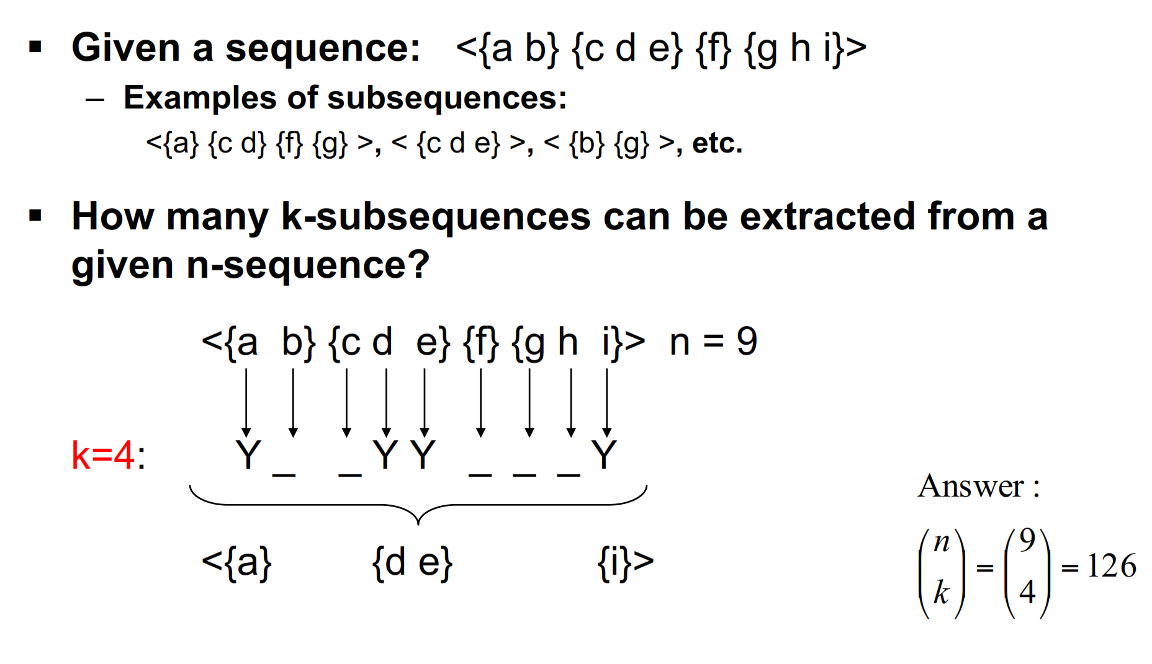
Challenge

Slide 87
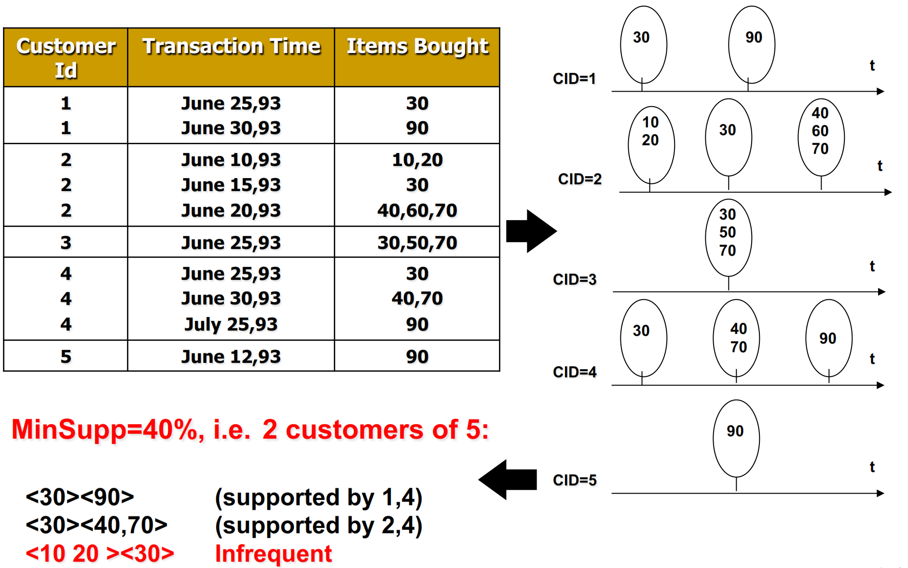
Example

Slide 88
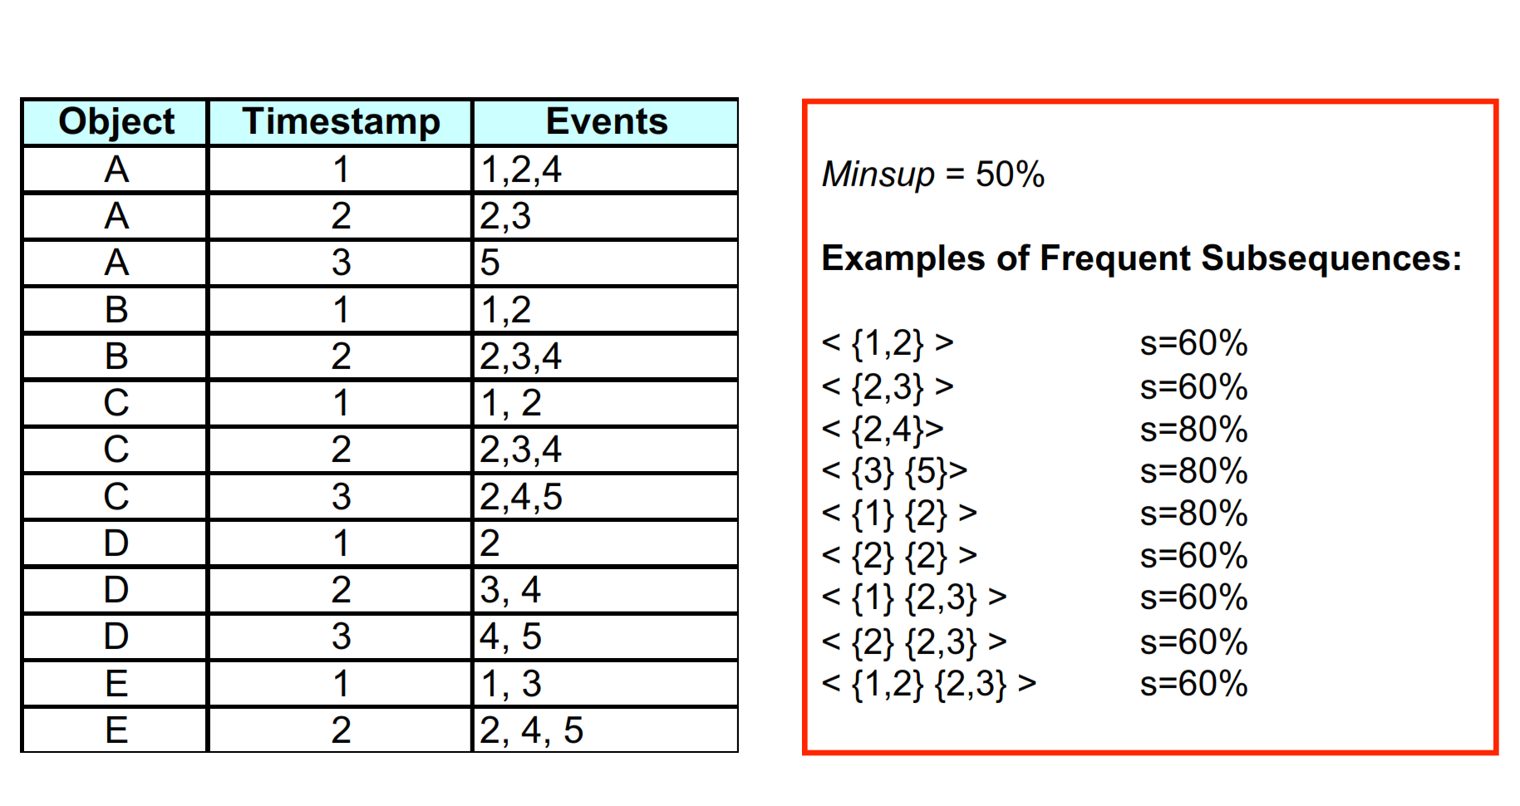
Example

Slide 89
Sequential Pattern
Sequential pattern is computationally challenging because such mining may generate combinationally explosive number of intermediate subsequences.
For efficient and scalable sequential pattern mining two common approaches are:
Mining the full set of sequential patterns
Mining only the set of closed sequential pattern
A sequence database is a set of tuples with sequence_ID and sequences. Eg
Sequence_ID | Sequence
1 | {(a, (a,b,c), (a,c), (b,c)}
2 | {(a,b,c), (a,d),e,(d,e)}
3 | {( c,d), (a,d,e),e}
4 | { (e,f,),d,(a,b,c),f]

Slide 90
Sub-graph Patterns
It finds characteristics sub-graphs within the network.
It is a form of graph search.
Given a labeled graph data set, D = {G1, G2, …….,Gn}, a frequent graph has minimum support not less than minimum threshold support.
Frequent sub-graph pattern can be discovered by generating frequent substructures candidate and hence check the frequency of each candidate.
Apriori methos and frequent –growth are tow common basic methods for finding frequent sub-graph
Extend association rule mining to finding frequent subgraphs

Slide 91
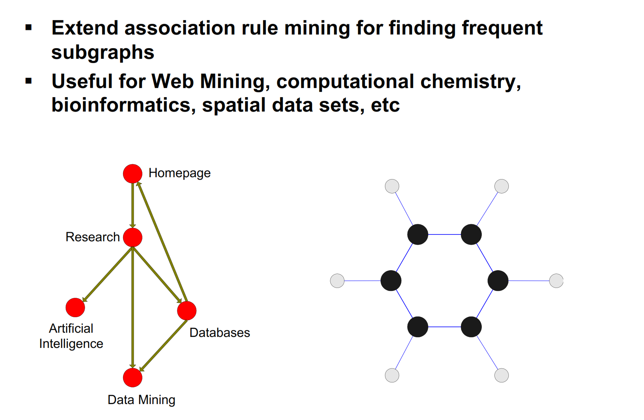
Example

Slide 92
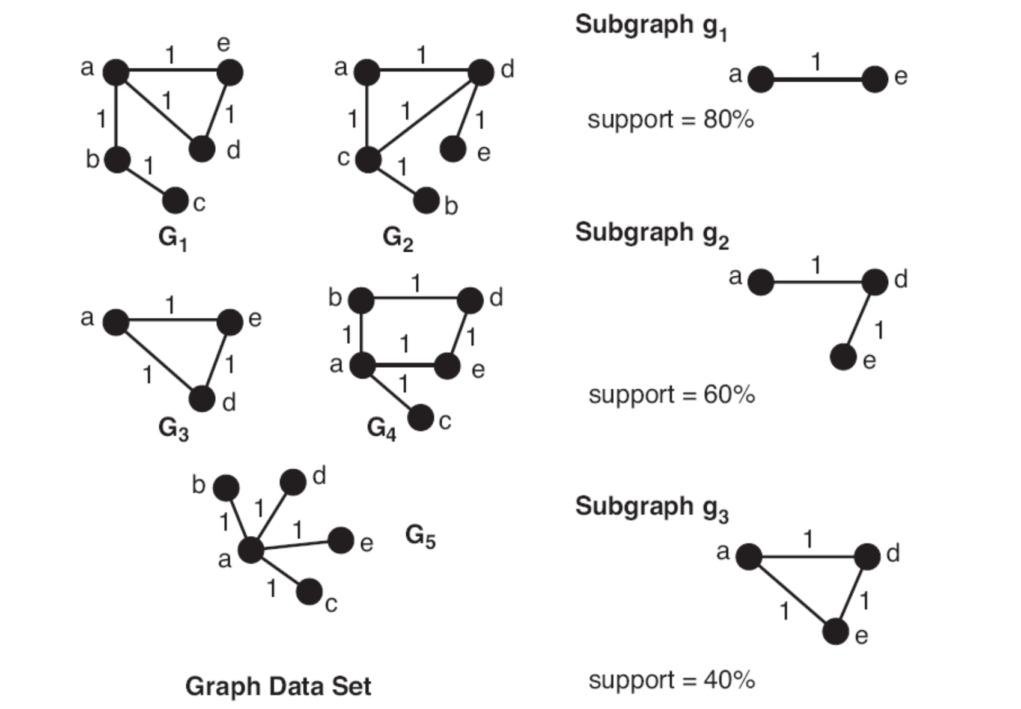
Example

Slide 93
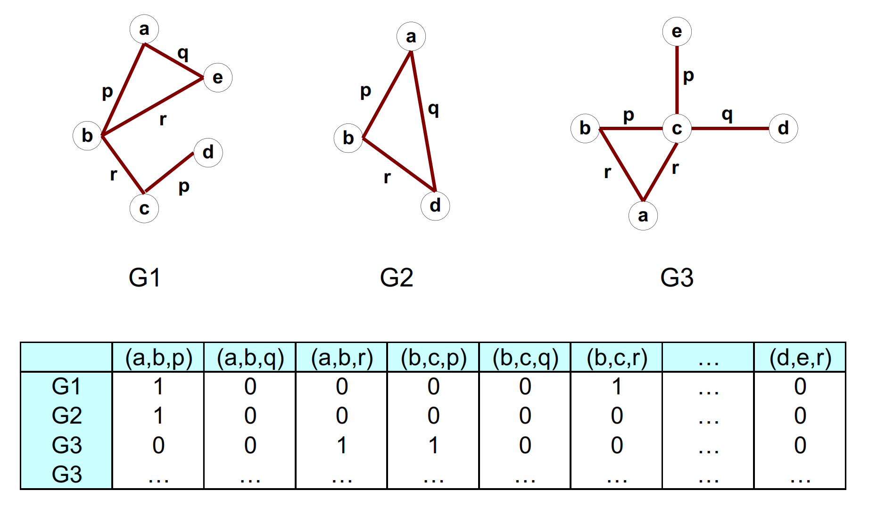
Representing Graph as transactions

Slide 94
What is frequent-pattern mining in Data Streams?
Frequent-pattern mining finds a set of patterns that occur frequently in a data set, where a pattern can be a set of items (called an itemset), a subsequence, or a substructure.
A pattern is considered frequent if its count satisfies a minimum support. Scalable methods for mining frequent patterns have been extensively studied for static data sets.
Challenges in mining data streams:
Many existing frequent-pattern mining algorithms require the system to scan the whole data set more than once, but this is unrealistic for infinite data streams.
A frequent itemset can become infrequent as well. The number of infrequent itemsets is exponential and so it is impossible to keep track of all of them.

